Slide 1
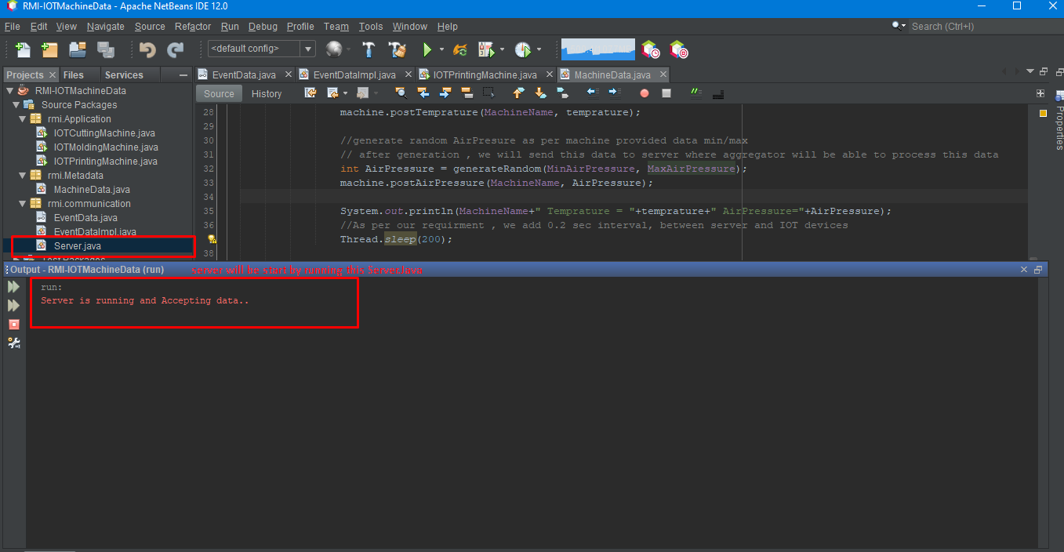
Start Server:

Slide 2
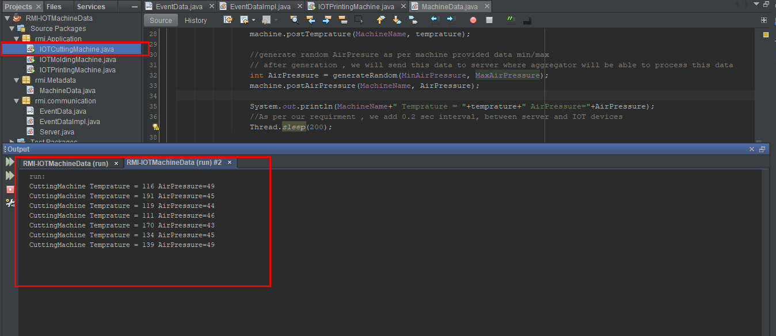
Run IOT Device : IOT Sensor for Cutting machine

Slide 3
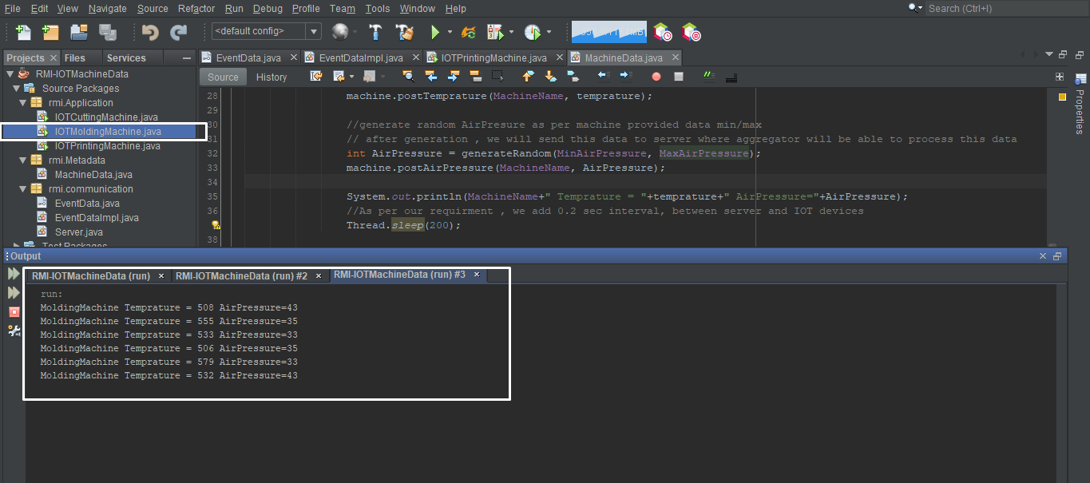
Run IOT Device : IOT Sensor for Molding machine

Slide 4
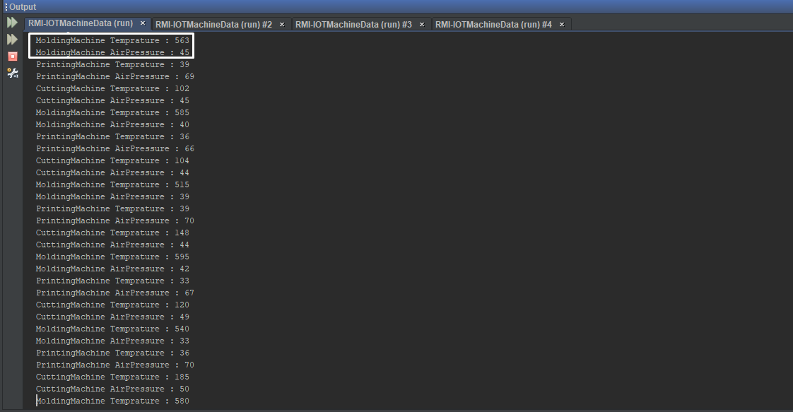
Receiving all Data on server to process on aggregator

Slide 5
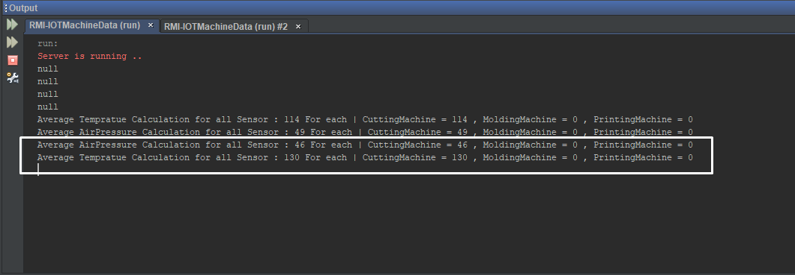
Aggregator 1 : A moving average of temperature over the last 50 samples, providing an average for each sensor and an average for all sensors.

Slide 6
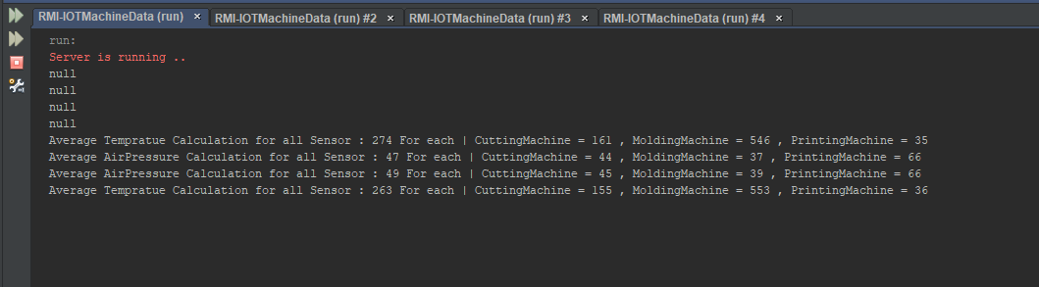
Aggregator 2 : A moving average of pressure over the last 100 samples, providing an average for each sensor and an average for all sensors.

Slide 7
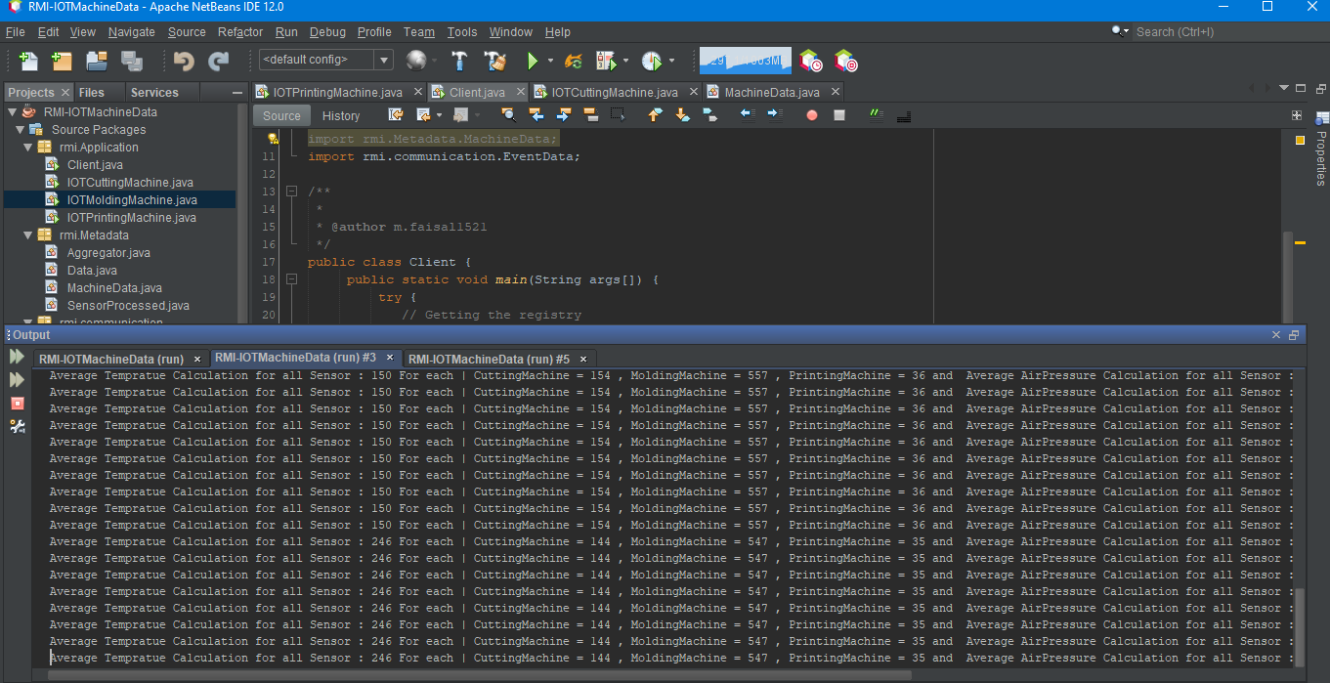
Client : Get Lastest data from both Aggregators :

